Slide 1
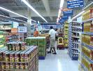
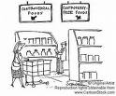
Form 4
Commercial studies
Types of Retail Outlet

Slide 2
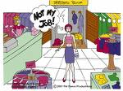
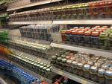
Hypermarket
There are three main types of
Retail Outlet. One of them are :
Multiple shop
Department store
1.Large-scale retailers:
a) Multiple shop (chain store)
b) Department store
c) Variety chain store
d) Supermarket
e) Hypermarket
f) Mail order business
Mail order business
Variety chain store
Supermarket

Slide 3
Features of Large – scale retailing
Capital needed is very large.
Normally run as a public limited company
Reason why large retailers buy direct from Manufacturers
Better trade discount
→buying from manufacturers means the retailers at the large
retailers can get better trade discount, hence, they pay a lower
Price for their goods.
2)Cash payment
→since large retailers have sufficient capital, they can afford to
pay in cash.

Slide 4
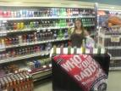
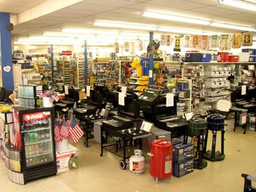
Types of large – scale retailers
Multiple shops (Chain store)
Main feature :
Goods sold usually on open display
So customer may personally examine
and select the goods. Price usually
market, sometimes it employs
self-service or shop assistant
Term
Term of sale normally cash.

Slide 5
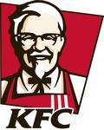
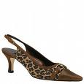
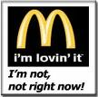
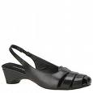
In Brunei example of multiple shop are fast food chains.
Kentucky Fried Chicken (KFC)
MacDonald’s
Or shop specializing in footwear
Example Bata.

Slide 6
Advantage of Large-scale retailing
To the costumers
Competitive price
Sometimes, the price is
Lower when large retailer
give
“special offers” to attract
customers.
2)One stop shopping
Customers finds it very
Convenient as they can do all
Their shopping under one roof
Due to the wide range of
goods offered by the various
Departments.
To the retailer
1) Buying in bulk
buying in bulk direct from
the manufacturer would give the
Large retailer better discounts therefore
A lower cost of goods.
2) Saving on transport
Since they buy in bulk, they can also have
Their own fleet of transport vehicle where its
More cheaper then hiring them from others

Slide 7
Disadvantages of Large-scale retailing.
To the costumers
To the retailer
1)Loss of the personal touch.
Customers have to forgo the “personal touch”when the buy goods from a larger retailer
where self-service is the offered.
2) No credit.
since a large retailer serves many customers who normally strangers,
Therefore they won’t offer any credit.
1)Large capital
Working capital is also very high.
A larger amount of capital is needed
since the business stocks a great variety
of goods which it buy in bulk direct from
the manufacturers.
2)High overheads
A large staff mean high wage bills.

Slide 8
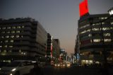
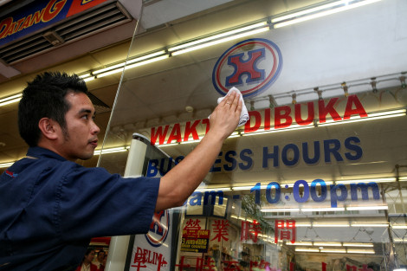
Department store.
Main Features :
1)It’s a large building divided into sections or departments, each
Selling one type of good.
2) Most department stores are found in the centre of a busy shopping
Area in a big city.
3)Example of department stores in Brunei are Hua Ho.

Slide 9
Advantage of Department stores.
A department stores is large and able to employ(take up)
Experienced and trained worker to handle the business efficiently.
Its economizes on advertising when all branches are
included in one advertisement
Disadvantages of Department stores.
It has a very high overhead e.g. rent
Normally departmental stores are located in the central part of the
city, high rental adds to overhead cost which can eventually raise
Price of goods.

Slide 10
Main Features:
1.Variety chain stores combined the features of multiple shop and
Department stores.
2.It occupied smaller premises and does not offer any facilities as the
Department stores.
Variety Chain Stores

Slide 11
Supermarket
Main Features:
1.The goods sold are normally foodstuff, personal and household goods
And branded goods where there are light and inexpensive goods.
2. Example : Jaya Supermarket In Kuala Lumpur and Yaohan in Singapore.

Slide 12
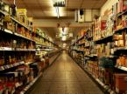
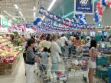
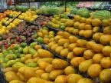
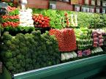
Here are some picture that
Where we can see at supermarket!

Slide 13
Advantages:
1.The supermarket buy in bulk direct from the manufacturer,
therefore they are able to sell customers at very competitive price.
2. Customers benefit from quick service and can take their own time to
select the supermarket is run efficiently.
Disadvantages:
1.Open displayed encourages shop lifting.
2. No personal services to consumers.

Slide 14
Hypermarket
Main Features:
1)A huge supermarket normally twice as large as supermarket where
the floor space can be greater than 2500 sq.meter and often
sided outside large town.
2)It attract shopper who want to buy large amount of goods.
3)Example : Boulevard in Miri, Giant in Kuala Lumpur.
Boulevard in Miri
Giant in Brunei

Slide 15
Advantages:
1.The supermarket buy in bulk direct from the manufacturer,
therefore they are able to sell customers at very competitive price.
2. Customers benefit from quick service and can take their own time to
select the supermarket is run efficiently.
Disadvantages:
1.Open displayed encourages shop lifting.
2. No personal services to consumers.

Slide 16
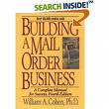
Mail order business
Mail order business is run by manufactures , department stores or specialist mail order warehouses.
Goods are ordered through mail .
Example of goods sold : Beg, costume, t-shirt, jewellery , books,
etc.
Main features

Slide 17
Advantages :
1.Customer can buy on credit.
2.Customer may return unwanted good easily.
Disadvantages :
1.Lack of personal contact.
2.Goods may be bought cheaper direct from the shop

Slide 18
Done by:
juLiana tan,
Abdul alif,
Aissah
&
Nasir~~
........¶¶¶¶¶¶...... ......¶¶¶¶¶¶ ....¶¶¶¶¶¶¶¶¶¶....¶¶ ¶¶¶¶¶¶¶¶ ..¶¶¶¶¶¶¶¶¶¶¶¶¶¶¶¶.. ......¶¶¶¶ ¶¶¶¶¶¶¶¶¶¶¶¶¶¶¶¶¶¶.. ......¶¶¶¶ ¶¶¶¶¶¶¶¶¶¶¶¶¶¶¶¶¶¶¶. ...¶¶¶¶¶ ¶¶¶¶¶¶¶¶¶¶¶¶¶¶¶¶¶¶¶ ..¶¶¶¶¶.. ....¶¶¶¶¶¶¶¶¶¶¶¶¶¶¶¶ ¶¶¶¶¶ ..........¶¶¶¶¶¶¶¶¶¶ ¶¶¶¶¶¶ ..............¶¶¶¶¶¶ ¶¶¶¶¶¶¶ ..................¶¶ ¶¶¶¶¶¶ .................... ..¶¶¶¶

