Slide 1
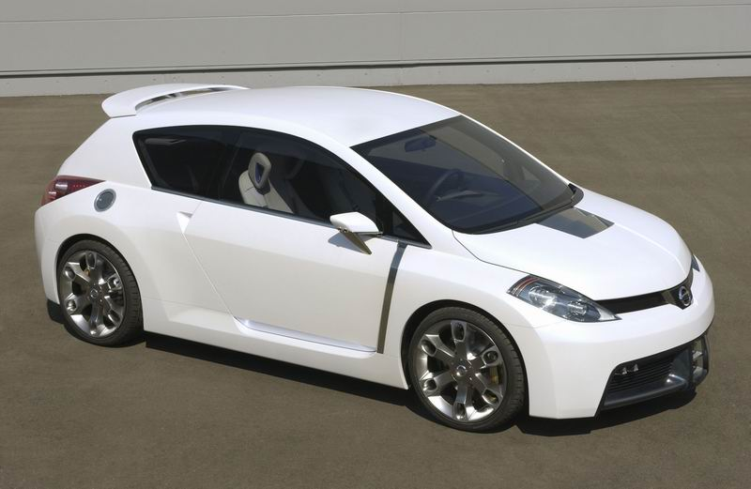

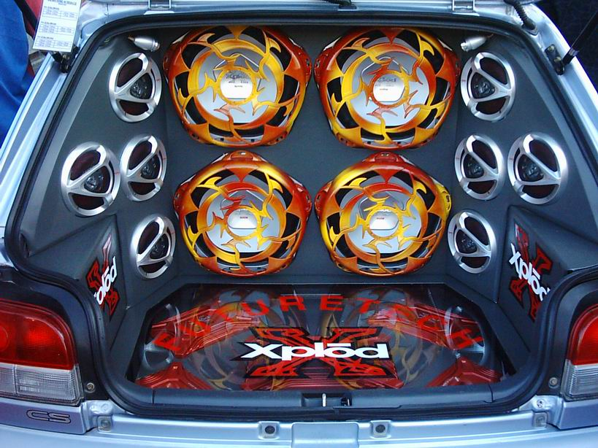
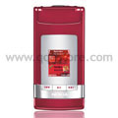

A
D
V
E
R
T
I
S
I
N
G
Sold : $48000
Sold : $256000
Bella : 8148191
Zai : 8742004
Kal : 8143831
Ruz : 8643836
Hj Ruzaini : 8148188
Sold : $ 548.00
Ruzkal : 8125610
Sold : $ 1500.00

Slide 2
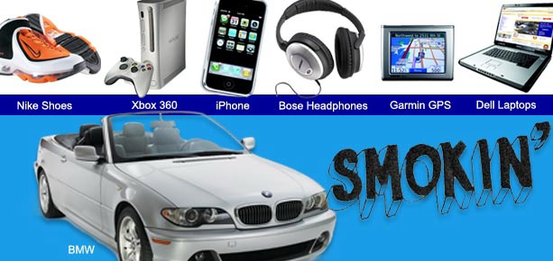
What is Advertising?
Oral
Visual message regarding a product
Service
Idea

Slide 3

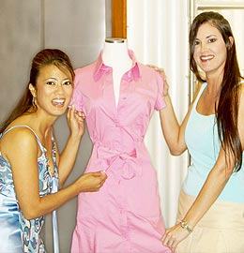
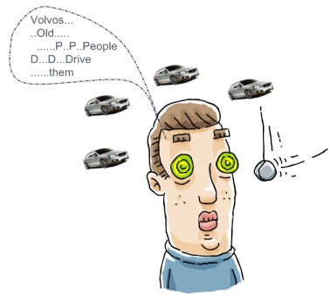
Purpose of Advertising
To Inform
2. To Persuade
3. To Remind

Slide 4
Types of advertising
Informative advertising – informing the public that a certain beverage has been developed.
Persuasive advertising – persuading consumers that Brand R is superior to other brands.
Reminder advertising – informing and reminding the public that a certain beverage is the only one.

Slide 5

Group work
List down 3 advantages of advertising for consumers.
List down 3 disadvantages of advertising for consumers.

Slide 6
Advantages And disadvantages For consumers
Advantages:-
Reminder of certain products.
Introduction to new products
Better informed consumers
Wider choice
Lower prices
Cheaper and better quality goods
Subsidized Production
Disadvantages:-
Higher prices for goods
Irrational choice of goods
Misleading claims
Rise monopolies

Slide 7
Danger of Advertising
He may be misled by false claims
He may have difficulty in choosing the brand
He may make unnecessary purchases
He may be irrational in his buying

Slide 8
Ways of advertising product
By Direct advertising – is on a person to person basis such as 1) Personal demonstration
2) Direct mail advertising and
3) Door to door canvassing.
By Indirect advertising – is directed at the general public such as 1) Press
2) Radio and television
3) Displays and
4) Outdoor.

Slide 9
Devices used in advertising
Sex appeal
Romance appeal
Economy Appeal
Appeal for manliness
Appeal for motherly love
Appeal for cleanliness
Appeal to safety
Appeal to prestige or status
Appeal for healthiness

Slide 10
Group work
List down 5 of the Advertising Media used by the advertisers to carry the advertising message.

Slide 11
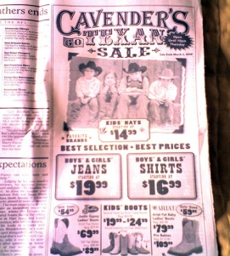
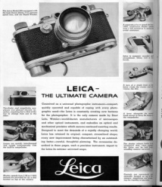
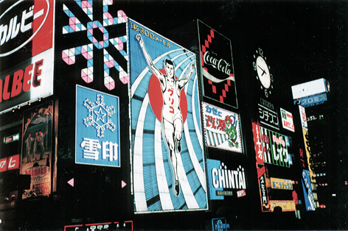

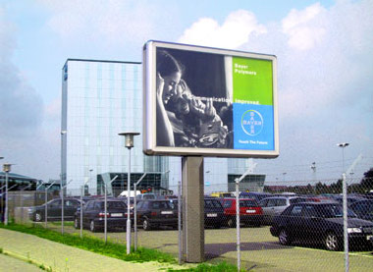
Advertising Media
Newspapers
Magazines
Radio
Television
Films
Direct Mail
Outdoor hoardings and signs
Pamphlets and samples
Travelling salesmen
Window displays and exhibitions

Slide 12


Slide 13






S
h
o
e
A
d
v
e
r
t
Watch Advert
A camera commercial

